Slide 1
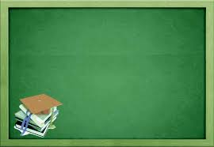
DIGESTIVE GLANDS

Slide 2
What are glands?
Glands are organs in the human or animal body which secrete a particular chemical substances for use in the body or for discharge into the surroundings.

Slide 3
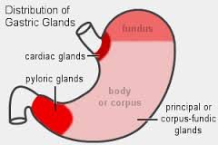
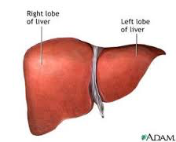
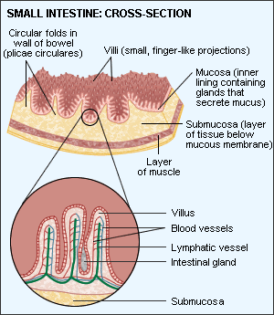
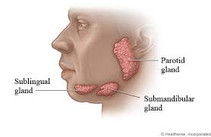
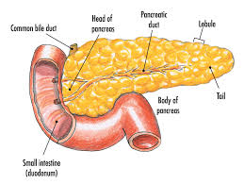
Digestive glands include the following:
Salivary glands
Gastric glands
Liver
Pancreas
Intestinal glands

Slide 4
What are digestive enzymes?
Digestive enzymes are bio-catalysts that break down food into simpler nutrients so that it can be absorbed.
These enzymes make up a crucial part of the digestive process known as chemical digestion and act along with mechanical digestion (chewing and churning) to allow for maximum absorption.

Slide 5

Salivary Glands

Slide 6
The three pairs of salivary secrete saliva. Saliva contains the following enzymes:
Salivary amylase
Lysozyme
Electrolytes
Salivary amylase helps in starch digestion up to 30%.
salivary amylase
Starch maltose
pH6.8

Slide 7
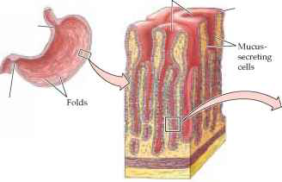
Gastric glands

Slide 8
The inner lining of stomach secretes gastric juice and mucous .
The mucous lining protects the stomach against the action of Hydrochloric acid.
Gastric jucie contains hydrocholric acid and two enzymes - pepsin and renin.

Slide 9
Hydrochloric acid kills bacteria which may have accompanied the food.
Also, it converts inactivated form of pepsin into the activated form.

Slide 10
Small amount of protein digestion (by pepsin) occurs in the stomach.
Pepsin
Proteins Proteases+ Peptides
Renin in infants helps in milk digestion.

Slide 11
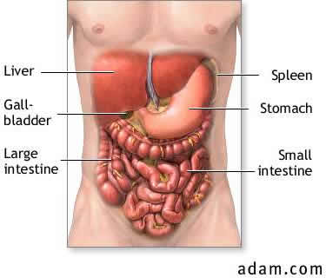
The liver is the largest gland of the body.
It is a reddish brown gland situated on the right side of the upper abdomen.
The main function of the liver is to secrete bile juice. Bile juice is stored in a sac- like structure called the gall bladder.

Slide 12
Bile takes part in the digestion of fats present in the ingested food.
Bile emulsifies fats which help in breaking them into small globules. In this way, fat globules are easily exposed to the action of fat-hydrolyzing, enzymes.
Although the bile juice received from the liver does not contain any enzymes, it is still essential for digestion since it breaks the fat globules into smaller droplets so that the enzymes could act on them efficiently (emulsification).

Slide 13
The acidic food coming from the stomach becomes alkaline, when it is mixed with the bile. It is an extremely important step which ensures further digestion of the food. The digestive enzymes that are brought in the duodenum and ileum can catalyse the breakdown of food only in alkaline medium.

Slide 14
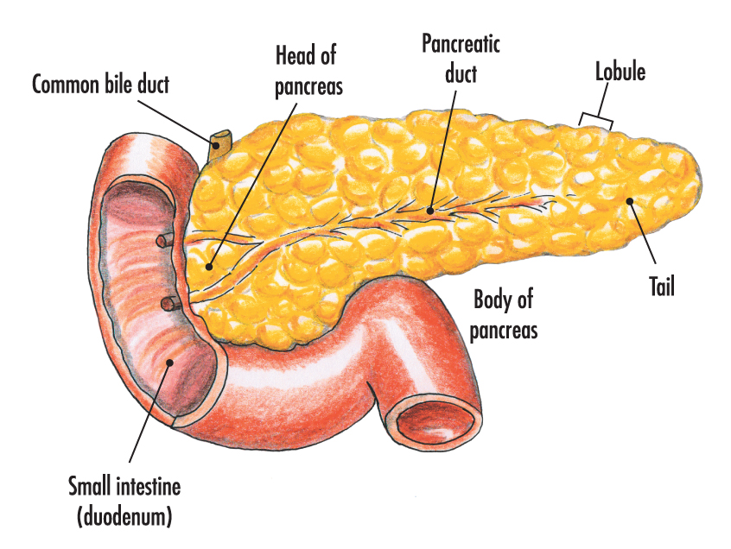
Pancreas
Pancreas is the second largest gland of the body.
It lies in the fold of duodenum and is cream yellowish in colour.

Slide 15
It secretes pancreatic juice, which contains protease, amylase and lipase enzymes.
These juices take part in the digestion of carbohydrates, lipids and proteins by breaking them intto simple substances for example, amylase breaks starch into maltose, while lipase breaks complex fats into simple fats

Slide 16
The small intestine is a highly coiled, tube-like structure and is about 7.5 meters in length.
The stomach empties its content into the small intestine.
It receives secretions from the liver and the pancreas In the form of bile and pancreatic juice.
Apart from this, the walls of the small intestine also secrete intestinal juice, succus entericus.

Slide 17
When the partly digested food reaches the small intestine, the juices secreted by the small intestine complete the process of digestion.
The secreted juices in the small intestines consist of maltase, sucrase, lactase, peptidase and lipase.

Slide 18
Three of the major enzymes present in the pancreatic juice are- trypsin, amylase and lipase.
Action of pancreatic juice results in:
Proteins Trypsin/Chymotrypsin
Peptones
Dipeptides
Proteoses
Nucleotidases Nucleosidases
Nucleic acid Nucleosides
Lipase
Fats Diglycerides Monoglycerides
Amylase
Starch Disaccharides

Slide 19
After being partially digested, the food moves to the second part of small intestine where it is acted upon by enzymes such as maltase, sucrase, and lactase.
Action of intestinal juice results in:
Dipeptidase
Dipeptides Amino acids
Lipase
Di and monoglycendes Fatty acids + Glycerol
Maltose/Lactose/Sucrose Maltase/Lactase/Sucrase
Nucleotidases
Nucleic Acid
Nucleotides
Nuceosidases
Nucleosides
Nucleosides
sugar+bases

